Slide 1
Varibles, Data Type, Comments

Slide 2
Objectives:
Variables
Data Type
Comments

Slide 3
Varibles
Variables are containers for storing data values.
A variable can have a short name (like x and y) or a more descriptive name (age, carname, total_volume).
Syntax in Java and C++
type variableName = value;
Syntax in Python
variableName = value

Slide 4
Rules
A variable name must start with a letter or the underscore character
A variable name cannot start with a number
A variable name can only contain alpha-numeric characters and underscores (A-z, 0-9, and _ )
Variable names are case-sensitive (age, Age and AGE are three different variables)

Slide 5
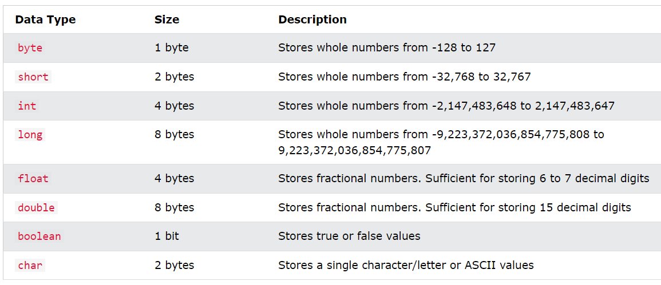
Data Types
Variables can store data of different types, and different types can do different things.
In Java:---

Slide 6
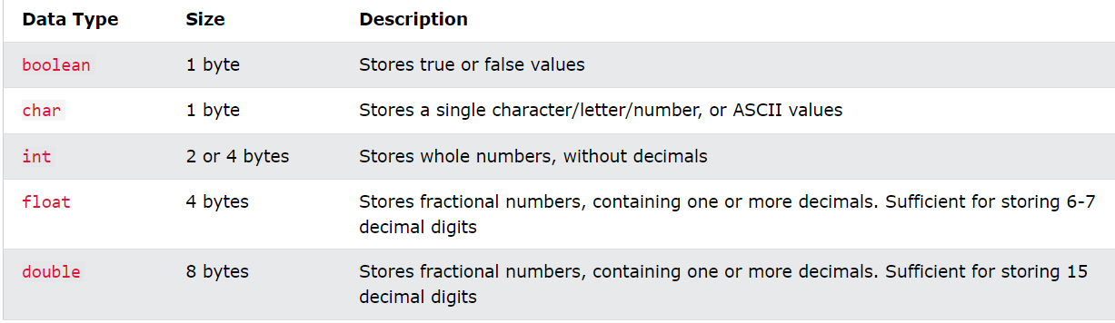
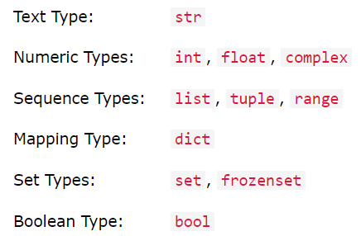
In C++:--
In python:-

Slide 7
Comments
Comments can be used to explain code.
Comments can be used to make the code more readable.
Comments can be used to prevent execution when testing code.
In Java and C++:-
Single-line comments start with two forward slashes (//)
Multi-line comments start with /* and ends with */
In Python:-
Comments starts with a #

Slide 8
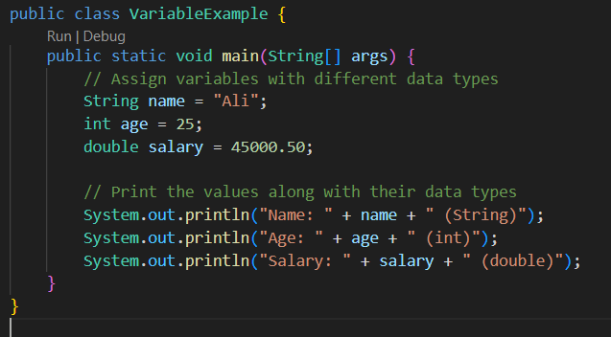
Example In Java:--

Slide 9
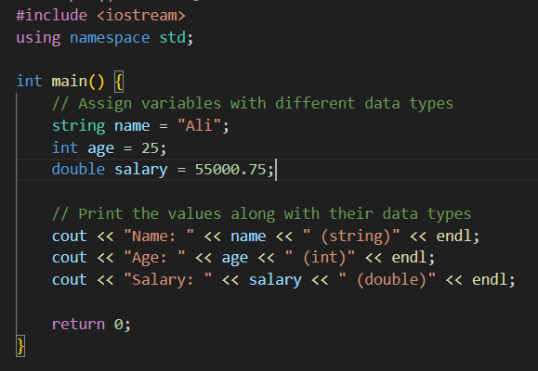
Example In C++:--

Slide 10
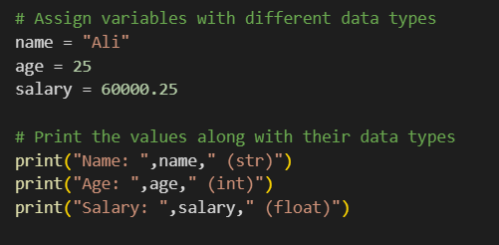
Example In Python:--

Slide 11
Task……..!
Assign two variables i.e. first name and last name, print both full name (using concatenation method) with Hello, massage…..
Assign three variable num 1 is 25, num 2 is 5 and num 3 is 15, applying arithmetic operations and store in new varibles. (num 3 – num 2, num 1 + num 3, num 1 / num 2 and num 1 * num 2)…..

